Slide 1
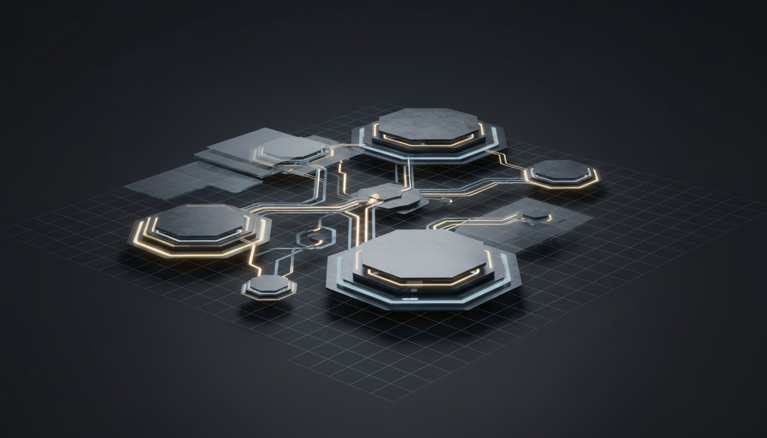
Minimal RAG
A Lightweight Retrieval-Augmented Generation Architecture

Slide 2
The Foundation
The Motivation for RAG
Knowledge Cutoff
Hallucination Risk
Domain Knowledge Gap
LLMs are trained on static datasets with a fixed knowledge cutoff date, making them unable to access recent information or evolving domain knowledge.
Without external validation, LLMs may generate plausible but factually incorrect responses, undermining trust in critical applications.
Generic LLMs lack access to proprietary or specialized information, limiting their effectiveness in enterprise and domain-specific contexts.
The RAG Solution
Retrieval-Augmented Generation bridges this gap by dynamically retrieving relevant context from external knowledge sources, grounding LLM responses in factual, up-to-date information.

Slide 3
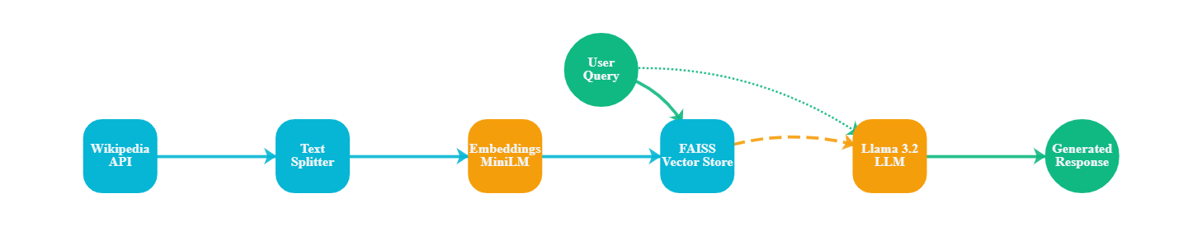
Core Components
System Architecture Overview
Ingestion Pipeline
Query Pipeline
Documents flow from Wikipedia API through text splitting and embedding generation into FAISS vector store for persistent retrieval.
User queries trigger semantic search in FAISS, retrieving top-k relevant chunks to augment LLM context for grounded generation.

Slide 4
Component 01
Data Ingestion Layer
Document Loading
Raw text is extracted from Wikipedia pages and normalized into a standardized document format, preserving content structure and metadata.
Wikipedia API
Public Knowledge Base
The entry point for document acquisition. Wikipedia provides structured, factual content spanning millions of topics.
Metadata Preservation
Each document retains source attribution, including article title and URL, enabling traceability and citation in generated responses.
Extensibility
The modular loader design supports easy integration of additional data sources: PDFs, databases, cloud storage, or enterprise repositories.

Slide 5
Component 02
Document Processing: Text Splitting
Hierarchical Strategy
Overlap Continuity
Index Tracking
Preserves semantic boundaries by recursively applying separators: paragraphs first, then sentences, then words.
200-character overlap prevents context loss at boundaries, ensuring concepts spanning multiple chunks remain retrievable.
Each chunk maintains its original position within the source document, enabling precise attribution during retrieval.

Slide 6
Component 03
Embedding Generation
Semantic Representation
Each text chunk is encoded into a 384-dimensional dense vector where semantically similar texts map to nearby points in vector space.
all-MiniLM-L6-v2
HuggingFace Embeddings
Text chunks are transformed into dense vector representations that capture semantic meaning, enabling similarity-based retrieval.
Efficiency & Speed
The MiniLM architecture delivers state-of-the-art retrieval performance with minimal computational overhead, processing thousands of chunks per second.
384
22M
Dimensions
Parameters
CPU-Optimized: Runs entirely on local CPU
Local Execution
No data leaves the local environment during embedding generation, ensuring complete privacy and eliminating API costs.

Slide 7
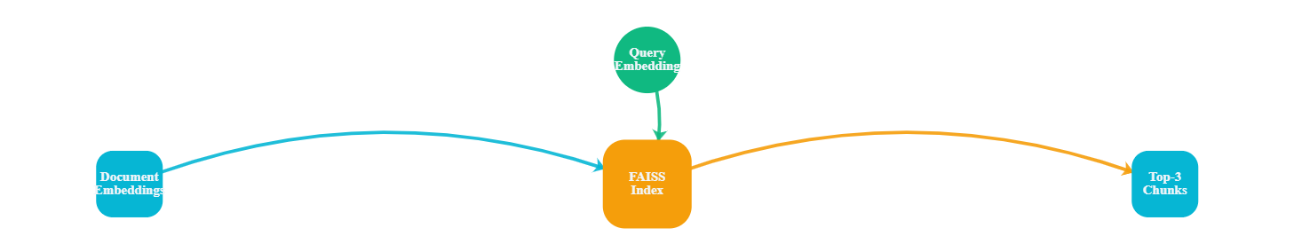
Component 04
Vector Storage & Retrieval
In-Memory Speed
Persistence
Cosine Similarity
FAISS stores vectors in RAM for millisecond-level query latency using optimized indexing structures.
Vector indices are serialized to disk and automatically reloaded on startup, eliminating recompute overhead.
Retrieval uses cosine similarity to measure semantic alignment, returning top-k most relevant chunks.

Slide 8
Component 05
Language Model & Generation
Context Augmentation
Retrieved chunks are formatted and injected into the prompt as context, grounding the model's response in factual, retrieved information.
Llama 3.2
Ollama Local Deployment
A 1B parameter language model that generates responses using retrieved context, running entirely locally for privacy and efficiency.
Hallucination Mitigation
1B
0
Explicit instructions constrain the model to use only provided context, dramatically reducing hallucination and ensuring response accuracy.
Parameters
Temperature
Deterministic: Temperature of 0 ensures consistent, focused responses.
Local Execution
Ollama hosts the model locally, eliminating network latency, API costs, and data privacy concerns associated with cloud-based LLM services.

Slide 9
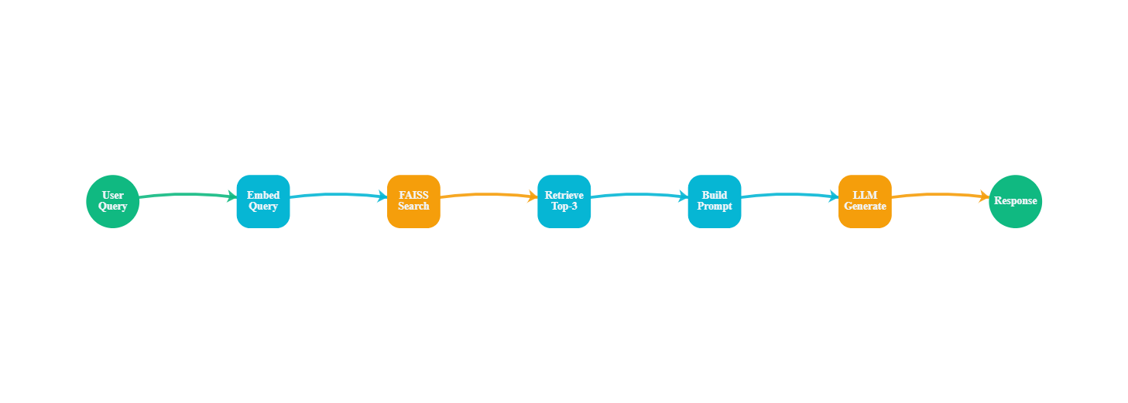
Integration
Complete End-to-End Flow
~50ms
~10ms
~2s
~2.5s
Embedding Time
FAISS Search
LLM Generation
Total Latency

Slide 10
Principles
Key Design Decisions
Privacy by Design
Context Preservation
All components execute locally. No data leaves the machine, ensuring complete privacy and compliance with data protection requirements.
Recursive splitting with strategic overlap maintains semantic continuity across chunks, improving retrieval quality.
Lightweight Models
Modular Architecture
MiniLM embeddings and 1B-parameter Llama enable fast inference on CPU, eliminating GPU requirements and reducing resource consumption.
Each component is independently replaceable. Swap embedding models, vector stores, or LLMs without disrupting the pipeline.
FAISS for Speed
Zero API Costs
In-memory vector storage delivers millisecond-level retrieval latency, enabling responsive real-time query processing.
Open-source models and local execution eliminate per-token pricing, making the system cost-effective at any scale.

Slide 11

Conclusion
Architecture Summary
With five core components running entirely locally, it delivers a foundation for building domain-specific, privacy-preserving AI applications.
Data Source
Text Splitter
Embeddings
Vector Store
LLM
Wikipedia API
LangChain
MiniLM
FAISS
Llama 3.2
Local Execution
Privacy First
Modular Design
Zero Cost

